Slide 1

CSE333
COMBINATORIAL STUDIES-I
Lecture #0
The kick start session

Slide 2
Course details
LTP – 3 0 0 [Three lectures/week]
Credit – 3

Slide 3
Assessment/Evaluation Scheme
Attendance: 5%
CA: 25%
MTT: 20%
ETT: 50%

Slide 4
Complete evaluation criteria for the course
CA1: 30 marks- Test (Online Quiz of 30 Questions)
To assess the students’ understanding on propositional logic, first order logic, sets, relations, functions, partial orders, lattices, groups,
Graphs : connectivity, matching, coloring
CA2: 30 marks- Test (Online Quiz of 30 Questions)
To assess the students’ understanding on counting, recurrence relations, generating functions
Linear Algebra : matrices, determinants, system of linear equations, eigenvalues, eigenvectors
CA3: 30 marks- Test (Online Quiz of 30 Questions)
To assess the students’ understanding on Calculus : limits, continuity, differentiability, maxima and minima, mean value theorem, integration
Probability : random variables, uniform, normal, exponential, poisson and binomial distributions, mean, median, mode, standard deviation, conditional probability, Bayes theorem, Numerical Ability

Slide 5

Revised Bloom’s Taxonomy

Slide 6
Course outcome
Through this course students should be able to:
CO1 :: solve various problems on propositional logic, first order logic, sets, relations, functions, partial orders, lattices, and groups.
CO2 :: identify and use fundamental concepts of graph theory and formulae of Combinatorics to solve problems.
CO3 :: make use of theories and formulae to solve problems of matrices, determinants, linear equations, eigenvalues, eigenvectors, and LU decomposition.
CO4 :: apply fundamental concepts of limits, continuity, differentiability, maxima and minima, mean value theorem, and integration in order to solve complex problems.
CO5 :: demonstrate the ability to solve problems on random variables, uniform, normal, exponential, poisson and binomial distributions, mean, median, mode, standard deviation, conditional probability, and Bayes theorem.
CO6 :: demonstrate the ability to solve problems on numerical computation, numerical estimation, numerical reasoning, and data interpretation.

Slide 7
Program Outcomes
PO1
Engineering knowledge:Apply the knowledge of mathematics, science, engineering fundamentals, and an engineering specialization to the solution of complex engineering problems.
PO2
Problem analysis::Identify, formulate, research literature, and analyze complex engineering problems reaching substantiated conclusions using first principles of mathematics, natural sciences, and engineering sciences.
PO3
Design/development of solutions::Design solutions for complex engineering problems and design system components or processes that meet the specified needs with appropriate consideration for the public health and safety, and the cultural, societal, and environmental considerations.
PO4
Conduct investigations of complex problems::Use research-based knowledge and research methods including design of experiments, analysis and interpretation of data, and synthesis of the information to provide valid conclusions.

Slide 8
Program Outcomes
PO5
Modern tool usage::Create, select, and apply appropriate techniques, resources, and modern engineering and IT tools including prediction and modeling to complex engineering activities with an understanding of the limitations.
PO6
The engineer and society::Apply reasoning informed by the contextual knowledge to assess societal, health, safety, legal and cultural issues and the consequent responsibilities relevant to the professional engineering practice.
PO7
Environment and sustainability::Understand the impact of the professional engineering solutions in societal and environmental contexts, and demonstrate the knowledge of, and need for sustainable development.
PO8
Ethics::Apply ethical principles and commit to professional ethics and responsibilities and norms of the engineering practice.

Slide 9
Program Outcomes
PO9
Individual and team work::Function effectively as an individual, and as a member or leader in diverse teams, and in multidisciplinary settings.
PO10
Communication::Communicate effectively on complex engineering activities with the engineering community and with society at large, such as, being able to comprehend and write effective reports and design documentation, make effective presentations, and give and receive clear instructions.
PO11
Project management and finance::Demonstrate knowledge and understanding of the engineering, management principles and apply the same to one’s own work, as a member or a leader in a team, manage projects efficiently in respective disciplines and multidisciplinary environments after consideration of economic and financial factors.
PO12
Life-long learning::Recognize the need for, and have the preparation and ability to engage in independent and life-long learning in the broadest context of technological change.
PO13
Competitive Skills::Ability to compete in national and international technical events and building the competitive spirit alongwith having a good digital footprint.

Slide 10
Course contents
Unit I
Discrete Mathematics : propositional logic, first order logic, sets, relations, functions, partial orders, lattices, groups
Unit II
Graphs : connectivity, matching, coloring
Combinatorics : counting, recurrence relations, generating functions

Slide 11
Course contents
Unit III
Linear Algebra : matrices, determinants, system of linear equations, eigenvalues, eigenvectors, LU decomposition
Unit IV
Calculus : limits, continuity, differentiability, maxima and minima, mean value theorem, integration

Slide 12
Course contents
Unit V
Probability : random variables, uniform, normal, exponential, poisson and binomial distributions, mean, median, mode, standard deviation, conditional probability, Bayes theorem
Unit VI
Numerical Ability : numerical computation, numerical estimation, numerical reasoning, data interpretation

Slide 13
Text & Reference Books
Text Books:
1. WILEY ACING THE GATE COMPUTER SCIENCE AND INFORMATION TECHNOLOGY by ANIL KUMAR VERMA, GAURAV SHARMA, KULDEEP SINGH, WILEY
References:
1. DATABASE SYSTEM CONCEPTS by HENRY F. KORTH, ABRAHAM SILBERSCHATZ, S.
SUDARSHAN, Mc Graw Hill Education
2. DATA COMMUNICATIONS AND NETWORKING by BEHROUZ A. FOROUZAN, Mc Graw Hill Education
3. COMPUTER ARCHITECTURE AND ORGANIZATION by JOHN P. HAYES, Mc Graw Hill Education
4. DIGITAL LOGIC DESIGN AND COMP ORGANIZATION by NIKROUZ FAROUGHI, MC GRAW HILL
5. GATE COMPUTER SCIENCE AND INFORMATION TECHNOLOGY by TRISHNA KNOWLEDGE SYSTEMS, Pearson Education India

Slide 14

Next Class: Discrete Mathematics

Slide 15
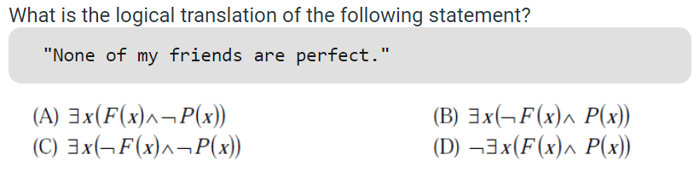
GATE CS 2013
© LPU :: CSE101 C Programming :: Dr. Lovi Raj Gupta

Slide 16
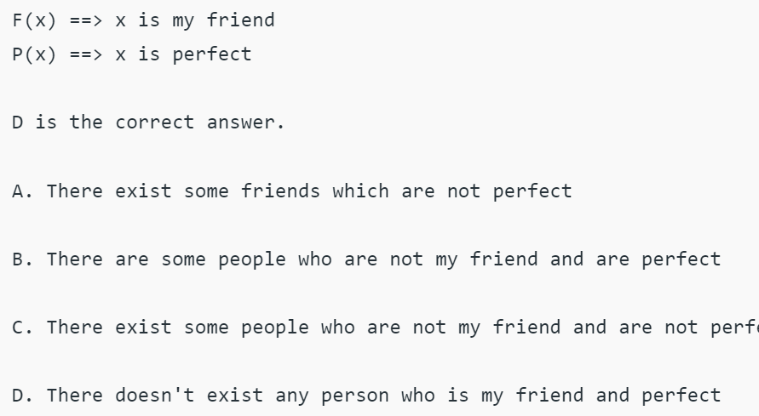
© LPU :: CSE101 C Programming :: Dr. Lovi Raj Gupta

Slide 17
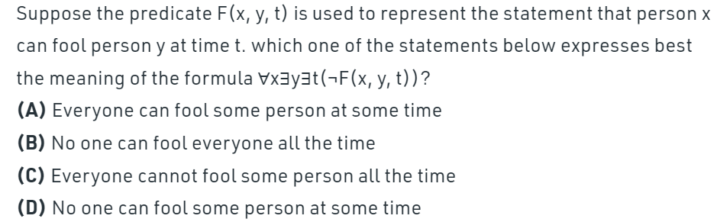
GATE CS 2010
© LPU :: CSE101 C Programming :: Dr. Lovi Raj Gupta

Slide 18
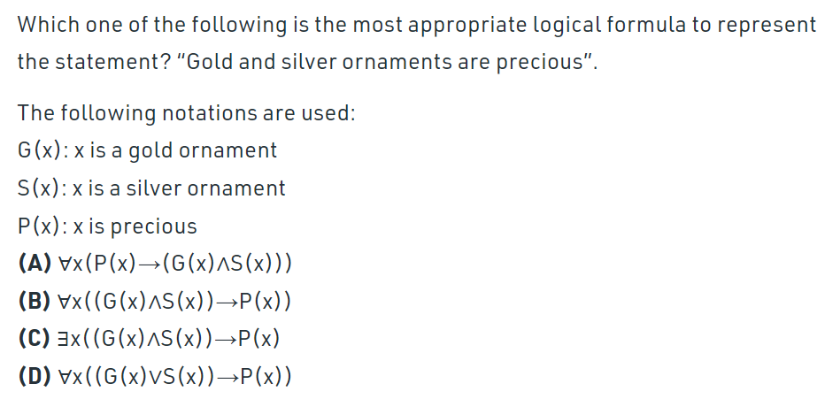
GATE CS 2009-D
© LPU :: CSE101 C Programming :: Dr. Lovi Raj Gupta

Slide 19
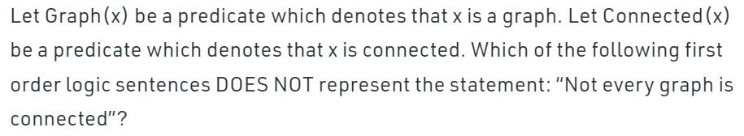
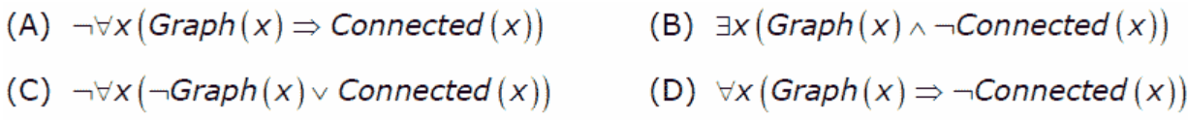
GATE CS 2007
© LPU :: CSE101 C Programming :: Dr. Lovi Raj Gupta_d

Slide 20
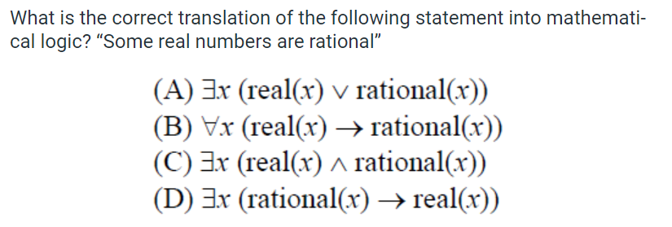
GATE CS 2012
© LPU :: CSE101 C Programming :: Dr. Lovi Raj Gupta

Slide 21
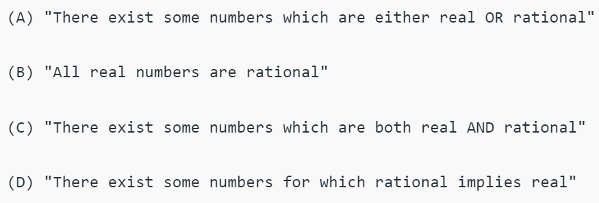
© LPU :: CSE101 C Programming :: Dr. Lovi Raj Gupta

Slide 22
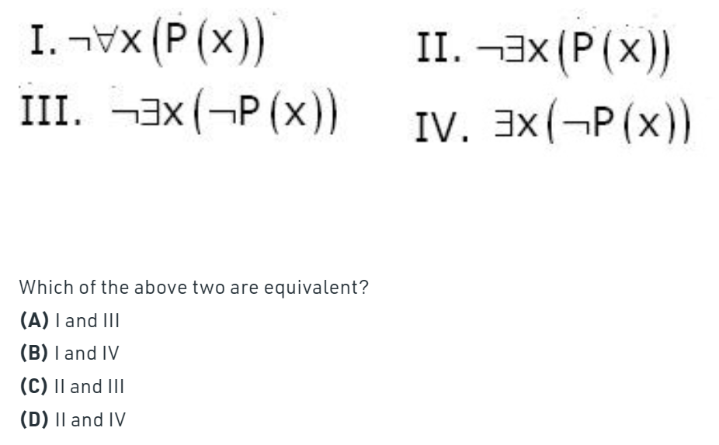

Slide 23
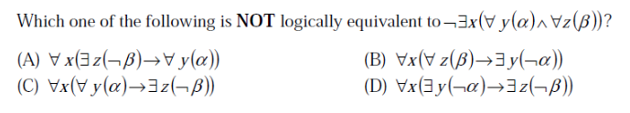
© LPU :: CSE101 C Programming :: Dr. Lovi Raj Gupta

Slide 24
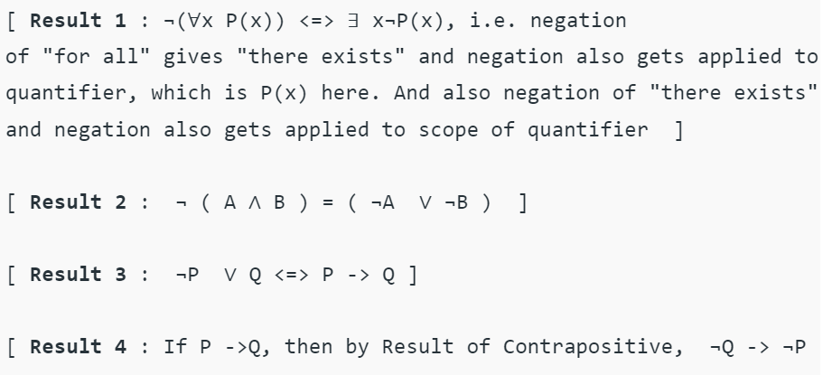
© LPU :: CSE101 C Programming :: Dr. Lovi Raj Gupta

Slide 25
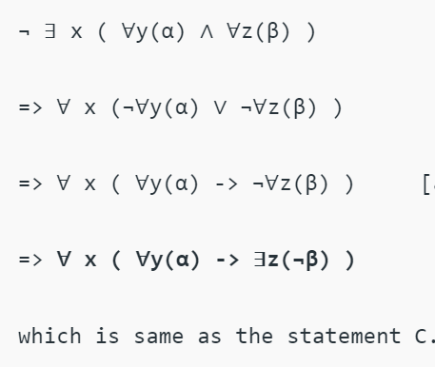
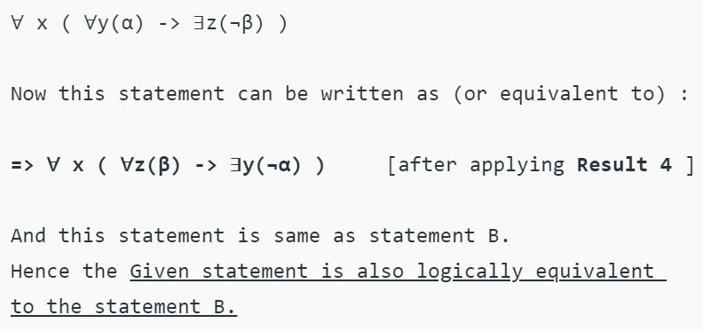
© LPU :: CSE101 C Programming :: Dr. Lovi Raj Gupta

Slide 26
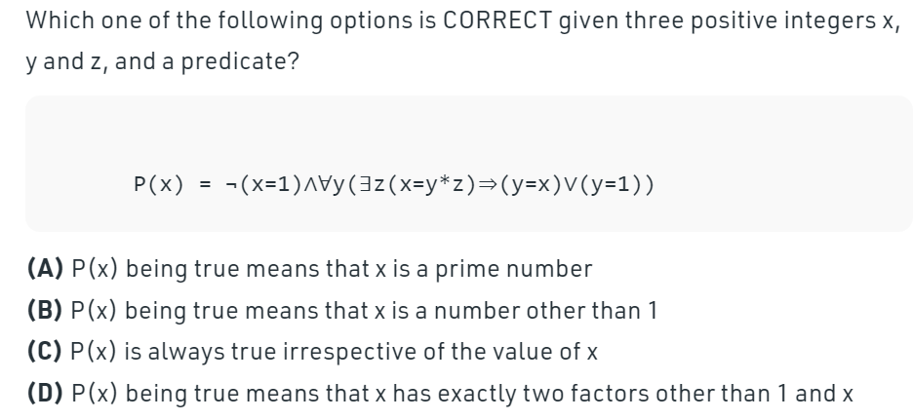
Ans is A
GATE CS 2011
© LPU :: CSE101 C Programming :: Dr. Lovi Raj Gupta_a

Slide 27
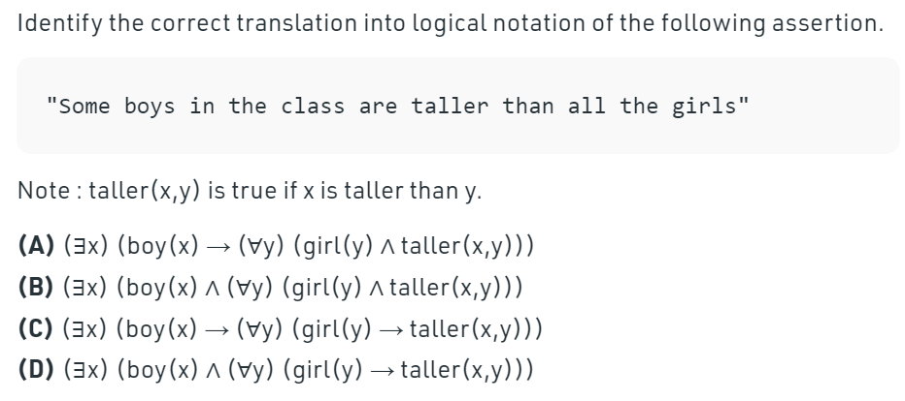
GATE CS 2004
D means there exist some boys x which taller than all girls y.
© LPU :: CSE101 C Programming :: Dr. Lovi Raj Gupta_a

Slide 28
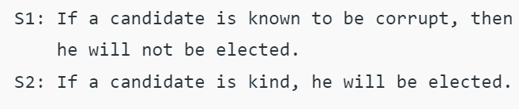
Which one of the following statements follows from S1 and S2 as per sound inference rules of logic?
(A) If a person is known to be corrupt, he is kind
(B) If a person is not known to be corrupt, he is not kind
(C) If a person is kind, he is not known to be corrupt
(D) If a person is not kind, he is not known to be corrupt GATE 2015
© LPU :: CSE101 C Programming :: Dr. Lovi Raj Gupta_C

